Slide 1
Process Management
Dept. of Information Technology,
Jadavpur University, Kolkata

Slide 2
What is a process?
A process is an execution of a program.
(Note the emphasis on `an’)
An OS uses the notion of a process to control execution of all programs in a uniform manner---irrespective of whether a program is a sequential program or a concurrent program
A programmer uses the notion of a process to achieve concurrency within an application, so that the application can execute faster

Slide 3
Process-Basic Concept
A process is a program in execution.
It is a unit of work within the system.
Program is a passive entity, process is an active entity.
Process needs resources to accomplish its task
  CPU, memory, I/O, files
  Initialization data
Process termination requires reclaim of any reusable resources

Slide 4
Process—Basic Concept
Single-threaded process has one program counter specifying location of next instruction to execute
  Process executes instructions sequentially, one at a time, until completion
Multi-threaded process has one program counter per thread
Typically system has many processes, some user, some operating system running concurrently on one or more CPUs
  Concurrency by multiplexing the CPUs among the processes / threads

Slide 5

The Process Model
Multiprogramming of four programs
Conceptual model of 4 independent, sequential processes
Only one program active at any instant

Slide 6
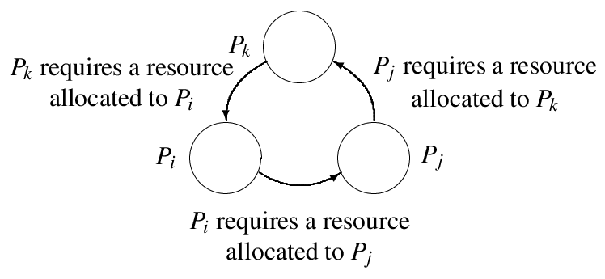
Process Management
Process Management
  Creating and deleting both user and system processes
  Suspending and resuming processes
  Providing mechanisms for process synchronization
  Providing mechanisms for process communication
  Providing mechanisms for deadlock handling

Slide 7
Example of processes in an application
Consider a satellite data logging application
  The satellite sends samples to earth periodically
  A computerized data logging application receives the sample in a special register and periodically writes them on a disk
This is a real time application as a sample has to be stored from the special register before the next sample is put into it
Three processes are created as shown on the next slide
  The OS creates one process for the application when its execution is initiated.
  This process creates other processes as its child processes

Slide 8

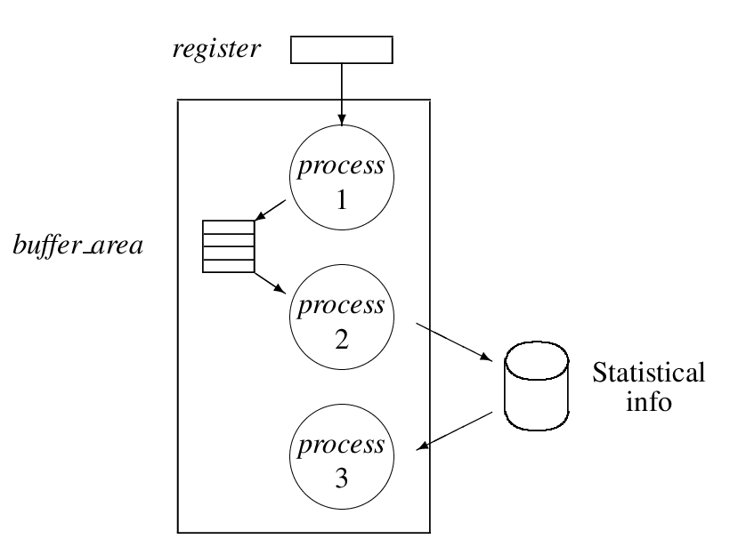
Tasks in real time application for data logging

Slide 9
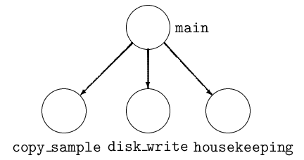
Process tree for the real time application

Slide 10
Advantages of child processes
Computation speed-up
  OS may interleave operation of CPU-bound and I/O-bound processes of an application; it speeds up operation of the application
Priority for critical functions
  A process could be created to perform a critical function. It can be assigned a high priority to satisfy any time constraints
Protecting a parent process from errors
  The kernel terminates a child process if an error occurs during its operation; however, the parent process is not affected
  Beneficial to execute untrusted code as a child process

Slide 11
Concurrency and Parallelism
Child processes of a process may be able to operate independent of one another. Is this concurrency or parallelism?
  Concurrency: Operation in a manner that gives the impression of parallelism, but actually only one process may operate at any time
  Parallelism: Operation at the same time. It is not possible unless
    The computer has many CPUs
    The processes are truly independent of one another
    The kernel can schedule them independently

Slide 12
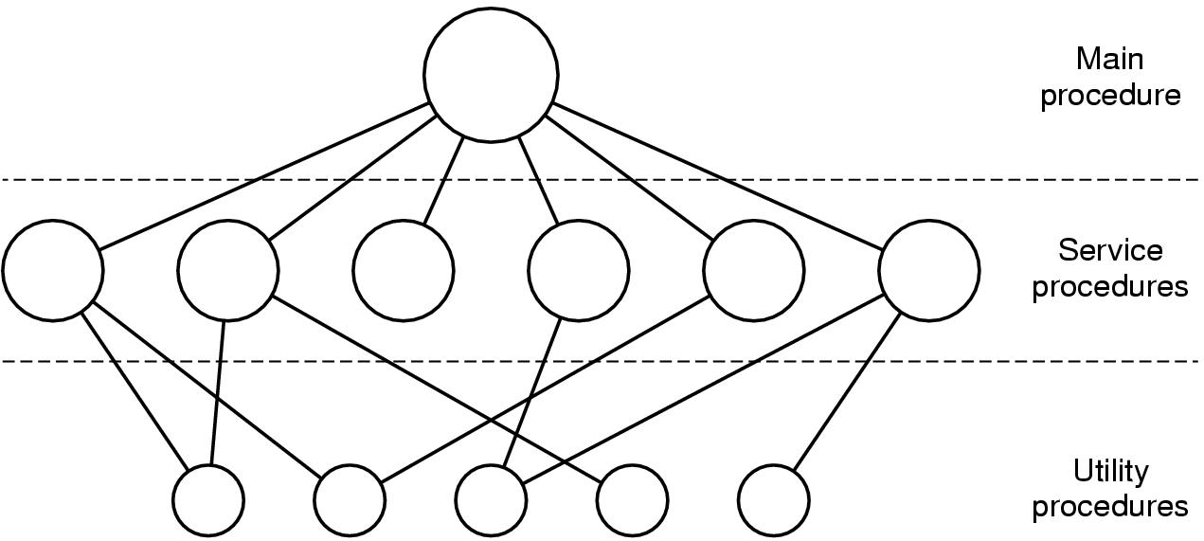
Operating System Structure
Simple structuring model for a monolithic system

Slide 13
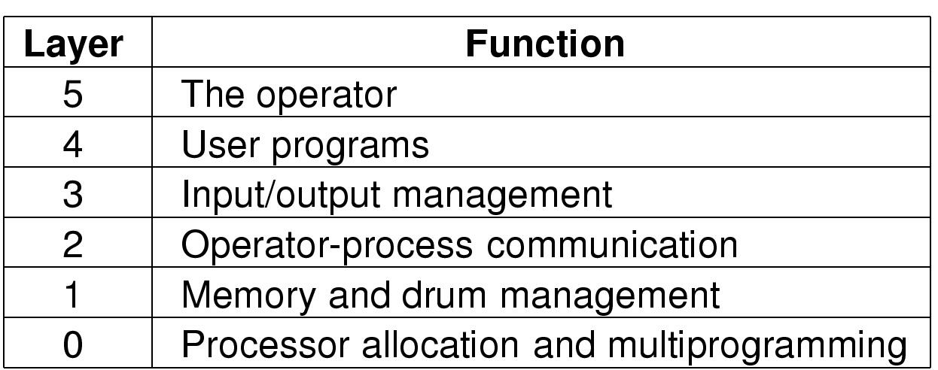
Operating System Structure
Structure of the THE operating system

Slide 14
OS view of a process
A process is a tuple with the following components
(id, code, data, stack, resources, CPU state)
  Code, data and the stack form the address space of the process
  The CPU state is comprised of the values in the CPU registers and in the fields of the PSW
  The process id is used by the OS to uniquely identify the process

Slide 15
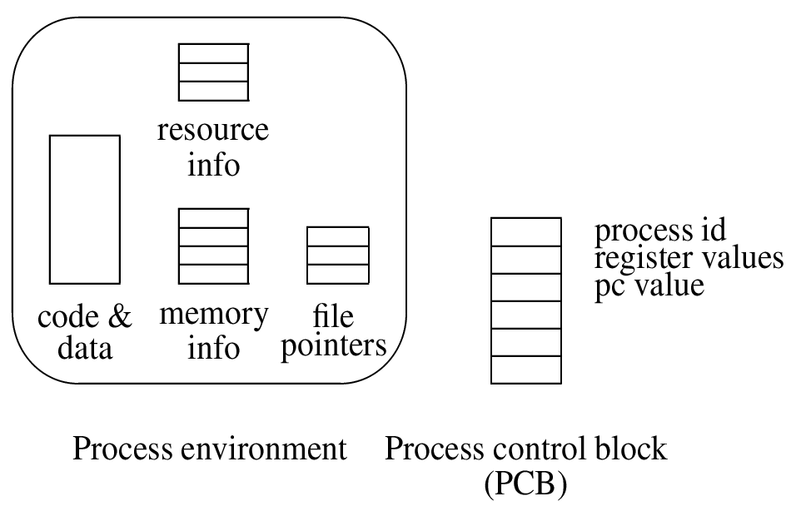
OS view of a process

Slide 16
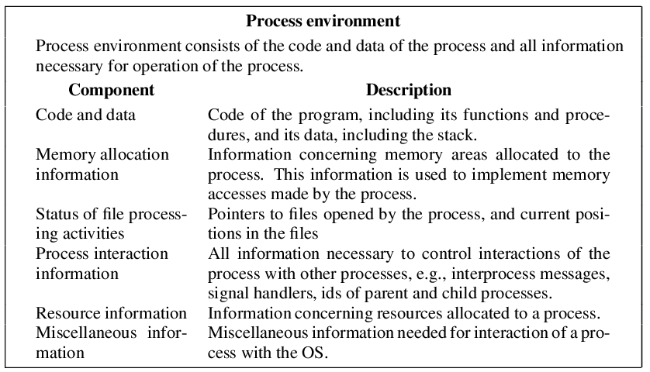
Components of the process environment
(also called the process context)

Slide 17
Fields of the process control block (PCB)
It is a kernel data structure that contain information concerning process id and CPU state
Process id
Ids of parent and child processes
Priority
Process state (defined later)
CPU state: It is comprised of
  PSW
  CPU registers
Event information
Signal information
PCB pointer

Slide 18
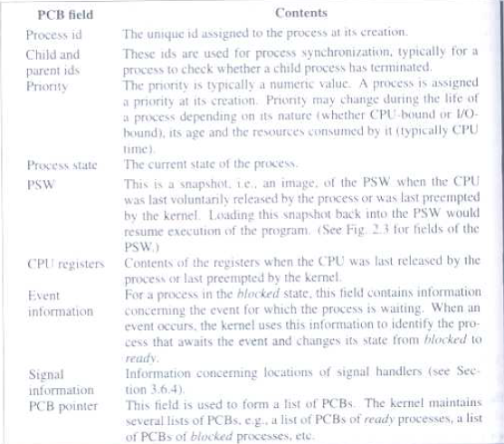

Slide 19
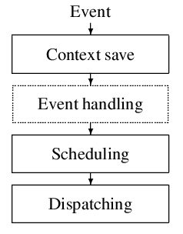
Fundamental functions for controlling processes by kernel

Slide 20
Context save
The CPU state indicates what the process executing on it is doing at any moment
Similarly, every resource allocated to a process has a state
  For example, the state of a file is the information about which record was accessed last, or which record it is about to access
The context save function saves the CPU state of the process, and states of resources allocated to it, so that the same can be used for resuming the process

Slide 21
Scheduling and dispatching
After an event has been handled, the kernel invokes the scheduling function to decide which process should be serviced next
The scheduling function identifies a process for servicing
The dispatching function loads the context of the identified process so that it starts or resumes its operation
  It involves loading CPU registers and the PSW, and other components of the saved context

Slide 22
Events
Process Creation
Process Termination
Timer Event
Resource Request Event
Resource Release Event
I/O Initiation
I/O Completion
Message Send
Message receive
Signal send
Signal receive

Slide 23
Event handling
Occurrence of an event is notified to the kernel through an
interrupt. It now performs the following tasks:
Find which event caused the interrupt
Take appropriate actions
  service a system call
  service a timer interrupt
  note that the I/O operation started by a process has ended

Slide 24
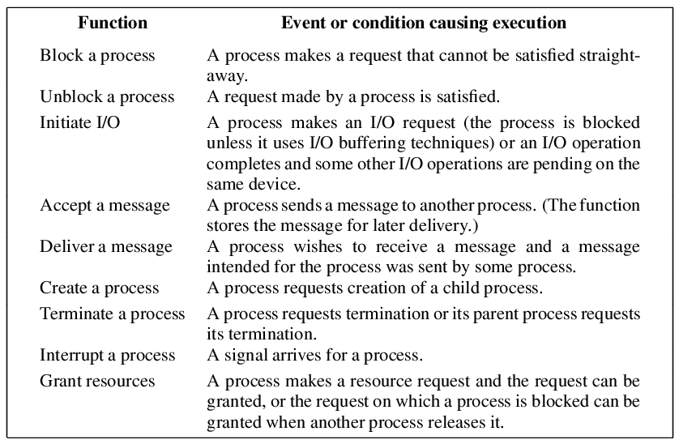
Event handling functions of an OS

Slide 25
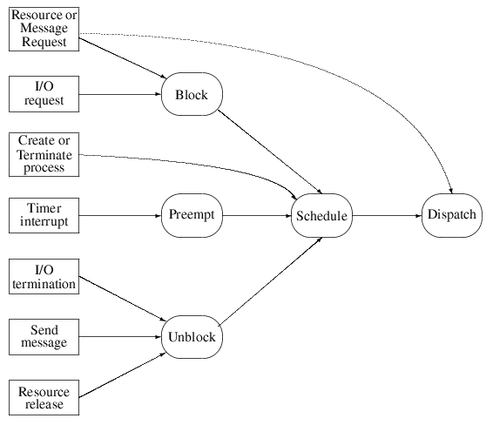
Event handling actions

Slide 26
Event handling
An OS has to determine which event caused an interrupt
It also has to determine which processes are affected in what manner by an event, so that it can change the states of these processes accordingly
It uses an event control block (ECB) to note information about an anticipated event and the process whose state would be affected by the event

Slide 27
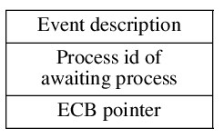
Event Control Block (ECB)

Slide 28
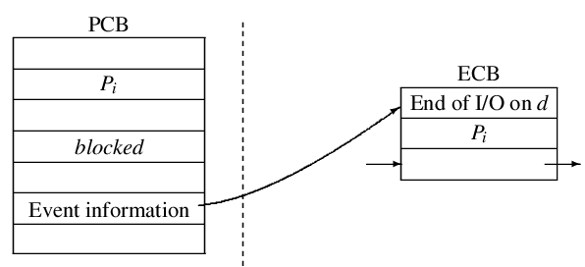
PCB-ECB interrelationship

Slide 29
Process States
A process state is an indicator of the current activity in a process
An OS designer defines process states to simplify functioning of the OS, e.g., for scheduling
The kernel keeps track of the state of a process and changes it as its activity changes
Different OSs may use different process states
Some sample process states
  A process is waiting for completion of an I/O operation
  The CPU is executing instructions of a process

Slide 30
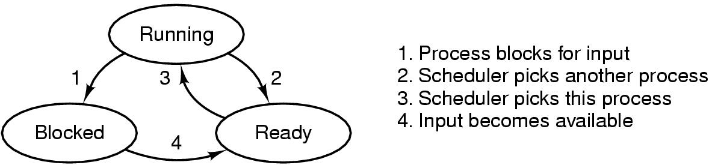
Process States
Possible process states
  running—Instructions are being executed
  Blocked—Process is waiting for some event to occur
  Ready—The process in waiting to be assigned to a processor
Transitions between states shown

Slide 31
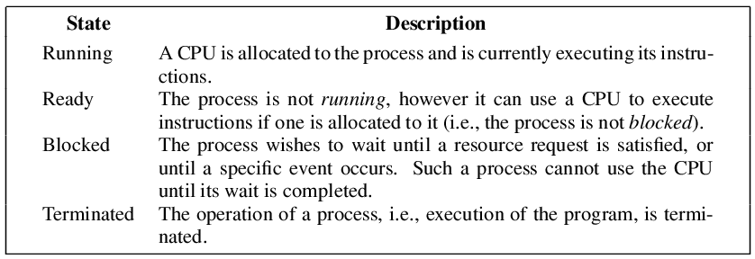
Fundamental process states

Slide 32
State transitions
The state of a process changes when the nature of the activity in it changes
This change of state is called a state transition
A state transition is caused by an event
Q: What are the events that cause transitions between the fundamental process states?

Slide 33
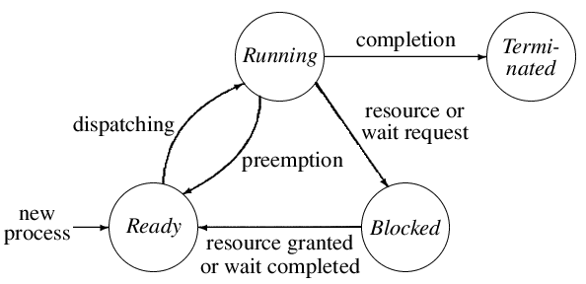
Fundamental state transitions for a process

Slide 34
Swapping and process states
An OS that uses swapping would have to define more states so that it can differentiate between processes that have been swapped out and those that have not been

Slide 35
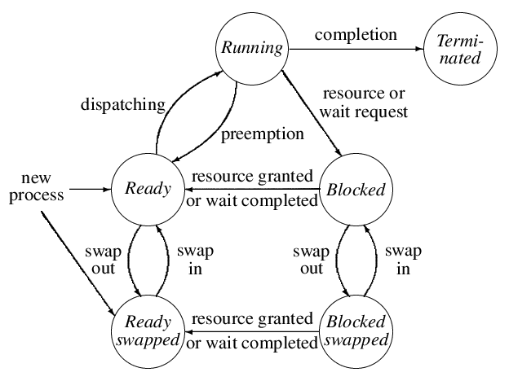
Process states and state transitions using two swapped states

Slide 36
Process Creation
Principal events that cause process creation
System initialization
Execution of a process creation system
User request to create a new process
Initiation of a batch job
Child_P = create_process(analysis(),3);

Slide 37
Process Termination
Conditions which terminate processes
Normal exit (voluntary)
Error exit (voluntary)
Fatal error (involuntary)
Killed by another process (involuntary)

Slide 38
Process Hierarchies
Parent creates a child process, child processes can create its own process
Forms a hierarchy
  UNIX calls this a "process group“
Windows has no concept of process hierarchy
  all processes are created equal

Slide 39
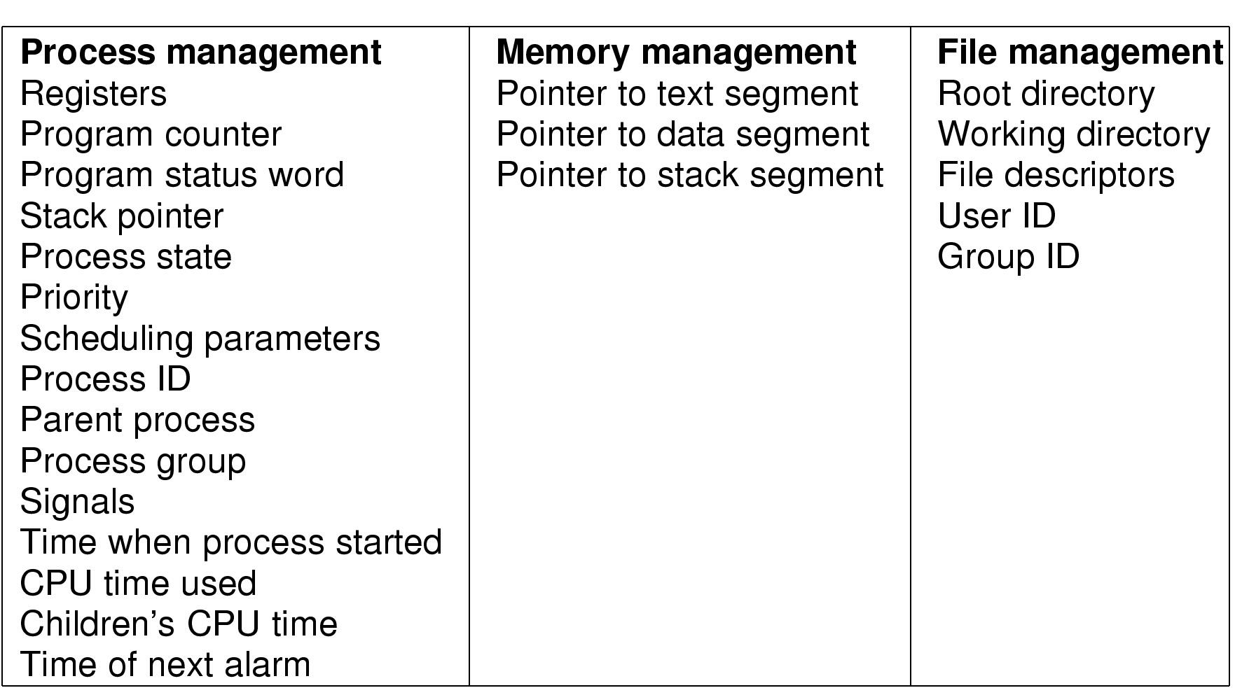
Implementation of Processes
Fields of a process table entry

Slide 40
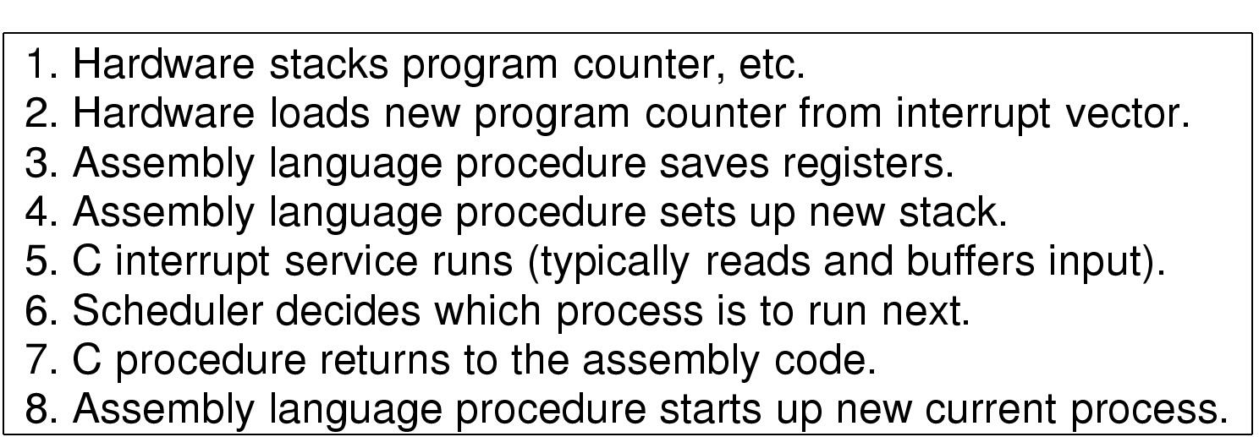
Implementation of Processes
Skeleton of what lowest level of OS does when an interrupt occurs

Slide 41

Steps in Making a System Call
There are 11 steps in making the system call
read (fd, buffer, nbytes)

Slide 42
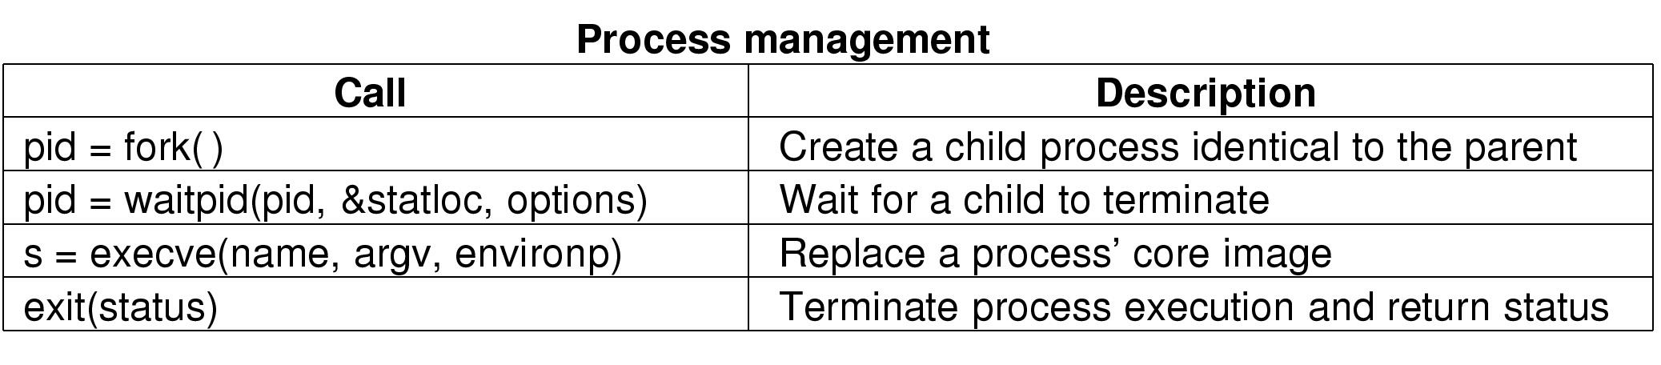
Some System Calls For Process Management

Slide 43
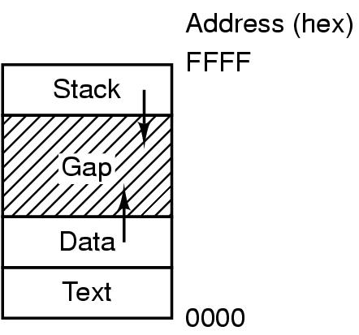
System Calls
Processes have three segments: text, data, stack

Slide 44
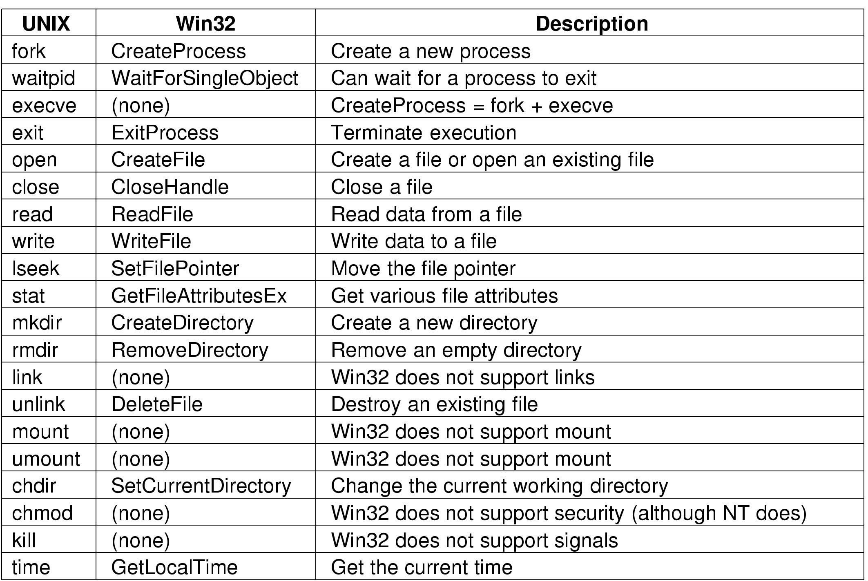
System Calls
Some Win32 API calls

